Slide 1
Personal Loan Campaign
Project 2 – Machine Learning
October 17, 2024

Slide 2
Contents / Agenda
Executive Summary
Business Problem Overview and Solution Approach
EDA Results
Data Preprocessing
Model Performance Summary
Appendix

Slide 3
Business Problem Overview and Solution Approach
Objective: We need to predict whether a liability customer will buy personal loans, understand which customer attributes are most significant in diving purchases, and identify exactly which segment of customers to target more.
Problem: When doing exploratory data analysis we noticed that more than 90% of customers did not take a personal loan – class imbalance in this variable.

Slide 4
Executive Summary - Call to Action
Key Predictors from the Decision Tree (in hierarchical order):
Income: Higher income often indicates a higher likelihood of loan acceptance. Customers with more disposable income may be targeted as they are more likely to qualify and show interest in loans.
CCAvg (Credit Card Spending): Customers who spend more on credit cards per month may be more likely to accept personal loans. They may already demonstrate a tendency to use credit, indicating potential demand for personal loans.
Education Level: Higher education levels (e.g., Graduate or Advanced degrees) often correlate with a higher likelihood of accepting loans, as educated customers might be more comfortable with financial products.
Ownership of Multiple Accounts: Customers with multiple accounts (e.g., securities or CD accounts) may be more engaged with the bank's financial products and are thus more likely to take out personal loans.
Mortgage: Customers with mortgages might need personal loans to finance home-related expenses or pay off higher-interest debts.

Slide 5

Executive Summary - Call to Action
Example of a Likely Customer Profile:
Age: Middle-aged (around 35–55 years old)
Income: High income (e.g., more than $100,000 per year)
CCAvg: Higher credit card spending (e.g., more than $2,500 per month)
Education: Graduate or Advanced degree
Account Ownership: Likely to have a securities account, CD account, or both
Mortgage: May have a mortgage, but not necessarily a very large one compared to income.

Slide 6

Executive Summary - Call to Action
Actionable Insights:
Target high-income customers with significant credit card spending.
Focus on customers with higher education levels as they may be more open to exploring financial products.
Engage customers who already have multiple accounts with the bank, as they may trust the bank’s offerings more.
Tailor campaigns to middle-aged customers (aged 30-50), who are often in their prime borrowing years.
This profile should guide future marketing teams to identify the best customers for targeted loan campaigns

Slide 7
Business Problem Overview and Solution Approach
The dataset has the following structure based on the first few rows:
Customer ID
Age (Years)
Experience
Income
ZIP Code
Family size of customer
Average spending on credit cards per month (in thousands of dollars)
Education level (given values of 1 for Undergrad, 2 for Graduate and 3 for Advanced/Professional degree)
Mortgage value of the customer’s house (Thousands)
Personal Loan – Binary value if accepted (0 for “No”, 1 for “Yes)
Securities Account (also a binary 0/1 value)
Certificate of deposit account (also binary 0/1 value)
Does customer use online banking facilities(also binary 0/1 value)
Does customer use credit card from another bank (also binary 0/1 value)

Slide 8
EDA Results
There are no missing values in the data set – all info is fully populated
Age: The mean/median average age of all customers is 45 years old, from a range of 23 to 67 years old
Experience: There is an outlier minimum of -3 years in the “Experience” column suggesting a data entry error. Otherwise, the mean value of workforce expereice is 20 years, from a range of 43 years for all
Income of customers ranges from $8000 - $224000 (in thousands) with a median income of $64,000 (in thousand dollars)
The median family has about 2 people with 4 being highest recorded maximum
Most customers have no mortgages (less than 50%) and did not take the loan (only 9.6% have loans)
Almost 90% have no securities account and almost 95% lack a CD account
Only 60% of customers seemingly use online banking and and about 30% of customers have credit cards with another bank

Slide 9
Data Preprocessing
Duplicate value check – No duplicates were found in the data - ran data.duplicated().sum() to check rows that were exact duplicates of others
Missing value treatment – No missing values in data set (this was verified previously)
Outlier check – performed an IQR analysis: 1) There were negative values in the “Experience” column – someone typed negative values as “experience” – this can be corrected. 2) Income and Mortgage both show high variability but this depended on whether extreme values are actually valid. We tested for Age, Income, Experience, Credit Card Spending and Mortgage outliers.
Feature Engineering
Data preprocessing for modeling

Slide 10
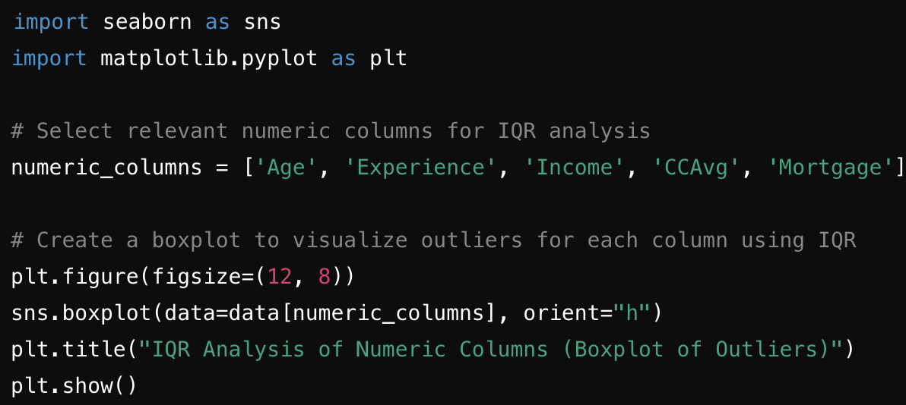
Data Preprocessing – Outlier Check
Outlier check – performed an IQR analysis: 1) There were negative values in the “Experience” column – someone typed negative values as “experience” – this can be corrected. 2) Income and Mortgage both show high variability but this dependsd on whether extreme values are actually valid. Outliers should be considered valid.
Testing for Age:
Q1 (25th percentile): 35 years
Q3 (75th percentile): 55 years
IQR (Interquartile Range): 20 years
Lower Bound: 5 years (no actual outliers below this in the dataset)
Upper Bound: 85 years (no actual outliers above this in the dataset)
Number of Outliers: 0
Code Snippet:

Slide 11
Data Preprocessing – Outlier Check
Outlier check – performed an IQR analysis: 1) There were negative values in the “Experience” column – someone typed negative values as “experience” – this can be corrected. 2) Income and Mortgage both show high variability but this dependsd on whether extreme values are actually valid. Outliers should be considered valid.
Experience:
Q1 (25th percentile): 10 years
Q3 (75th percentile): 30 years
IQR (Interquartile Range): 20 years
Lower Bound: -20 years (some corrections were done for negative experience values)
Upper Bound: 60 years (no actual outliers above this in the dataset)
Number of Outliers: 0 after fixing negative experience values
Code Snippet:

Slide 12
Data Preprocessing – Outlier Check
Outlier check – performed an IQR analysis: 1) There were negative values in the “Experience” column – someone typed negative values as “experience” – this can be corrected. 2) Income and Mortgage both show high variability but this dependsd on whether extreme values are actually valid. Outliers should be considered valid.
Income:
Q1 (25th percentile): $39,000
Q3 (75th percentile): $98,000
IQR (Interquartile Range): $59,000
Lower Bound: -$49,500 (no outliers below this, since income can't be negative)
Upper Bound: $186,500 (there are some outliers above this limit)
Number of Outliers: A few customers have incomes exceeding $186,500
Code Snippet:

Slide 13
Data Preprocessing – Outlier Check
Outlier check – performed an IQR analysis: 1) There were negative values in the “Experience” column – someone typed negative values as “experience” – this can be corrected. 2) Income and Mortgage both show high variability but this dependsd on whether extreme values are actually valid. Outliers should be considered valid.
CCAvg (Credit Card Average Spending):
Q1 (25th percentile): $700
Q3 (75th percentile): $2,500
IQR (Interquartile Range): $1,800
Lower Bound: -$1,900 (no outliers below this limit)
Upper Bound: $5,100 (some outliers above this limit)
Number of Outliers: A few customers spend more than $5,100 on average
Code Snippet:

Slide 14
Data Preprocessing – Outlier Check
Outlier check – performed an IQR analysis: 1) There were negative values in the “Experience” column – someone typed negative values as “experience” – this can be corrected. 2) Income and Mortgage both show high variability but this dependsd on whether extreme values are actually valid. Outliers should be considered valid.
Mortgage:
Q1 (25th percentile): $0 (many customers have no mortgage)
Q3 (75th percentile): $101,000
IQR (Interquartile Range): $101,000
Lower Bound: -$151,500 (no outliers below this limit)
Upper Bound: $252,500 (some customers have mortgages exceeding this)
Number of Outliers: A few customers have mortgages greater than $252,500
Code Snippet:

Slide 15
Data Preprocessing – Feature Engineering
We added new features to better assist in model construction:
1. Income to Mortgage Ratio – Mortgage Divided by Income
2. Total Accounts – A sum of the securities account, CD Account and Credit Card Ownership
3. Spending to Income Ratio – Average Credit Card Spending divided by Income
We then grouped (binning) customers into income brackets (low, medium or high) to simplify income analysis. This was done based on the Gaussian distribution of income levels
We also tried grouping the Age groups into young, middle aged and senior by the same measure

Slide 16
Data Preprocessing – Feature Engineering
We will convert categorical features such as Education, Income_Bin, and Age_Group into one-hot encoded variables. This process will help integrate categorical variables into machine learning models.
We will scale continuous features like Income, CCAvg, and Mortgage using the standard scaler from the scikit-learn library, which will normalize these values to ensure that they are on the same scale.
Each feature is rescaled using formula: z=(x−μ)/sd so it has a mean of 0 and an sd of 1​

Slide 17
Model Building
We can handle the class imbalance by using a decision tree classifier, which inherently handles some level of imbalance by focusing on information gain at each split. However, to further improve its performance on imbalanced data, we can adjust the class weights during training. This will give more importance to the minority class (customers who accepted the loan) while training the model.
To further improve this training model, we decided to split the dataset into 80% training data and 20% testing data
A decision tree classifier was trained on the aforementioned preprocessed data, with class balancing to handle class imbalance in the target variable (in this case Personal Loans)
Predictions were made on the test data sheet
Model performance was evaluated on Accuracy Precision, Recall and F1-Score

Slide 18
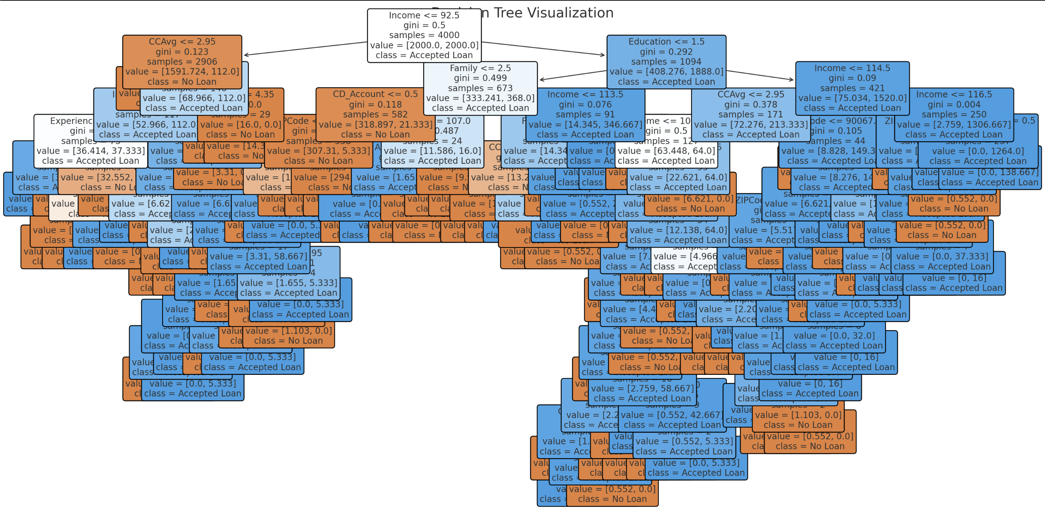
Business Problem Overview and Solution Approach
We can handle the class imbalance by using a decision tree classifier, which inherently handles some level of imbalance by focusing on information gain at each split. However, to further improve its performance on imbalanced data, we can adjust the class weights during training. This will give more importance to the minority class (customers who accepted the loan) while training the model.
The decision tree model's performance on the test set is as follows:
Accuracy: 98%
Precision for "No Loan": 99%
Precision for "Accepted Loan": 92%
Recall for "No Loan": 99%
Recall for "Accepted Loan": 90%
F1-score for "No Loan": 99%
F1-score for "Accepted Loan": 91%

Slide 19
Model Performance Summary
The decision tree model's performance on the test set is as follows:
Accuracy: 98%
Precision for "No Loan": 99%
Precision for "Accepted Loan": 92%
Recall for "No Loan": 99%
Recall for "Accepted Loan": 90%
F1-score for "No Loan": 99%
F1-score for "Accepted Loan": 91%

Slide 20
Model Performance Improvement
Additional features can be removed such as Zip Code if they are not showing any correlation or relevance to the training dataset
We focused narrowly on income and to a lesser extent age, as the key metric to judge a customer’s likeliness to take out a loan

Slide 21
APPENDIX

